Slide 1
CodeAbode
Server Side Integration

Slide 2
What is Javascript
Is Javascript a scripting language or is it a programming language ?
What is a Scripting Language ?
What environment does javascript need ?
Operating System?
Browser? Which Browser??
Can javascript only used to change behavior of HTML ?
Can javascript talk to Database? like PHP or Java does ?
Can you interface with Hardware with Javascript ?
Notes:
JavaScript is a programming language that you'll often hear it referred to as a scripting language, and sometimes you'll hear some software developers dismiss JavaScript as just being a scripting language. And what they mean by that is that JavaScript is intentionally limited. I can't write a desktop application in JavaScript the way I might do with C++ or Java or .NET or Objective-C.
There are no words in JavaScript to talk to a database or target a USB port. And that strikes some software developers as odd because most languages are all about input and output, and JavaScript isn't.

Slide 3
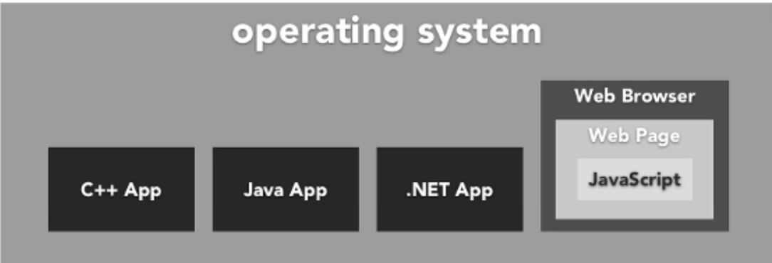
Why do you need Javascript?
Javascript was designed to manipulate web pages.
Where does javascript work (Enviornment) ?
Javascript is a client side language
Other Applications
Applications: Adobe Acrobat Photoshop
Server Side: Node.js, Google Apps Script
Notes:
JavaScript only works inside another application, the web browser. Whether that's IE or Safari or Firefox or Chrome or Opera, they all have a JavaScript engine inside them. The operating system runs the web browser, the web browser contains a page, and the page contains the JavaScript.

Slide 4
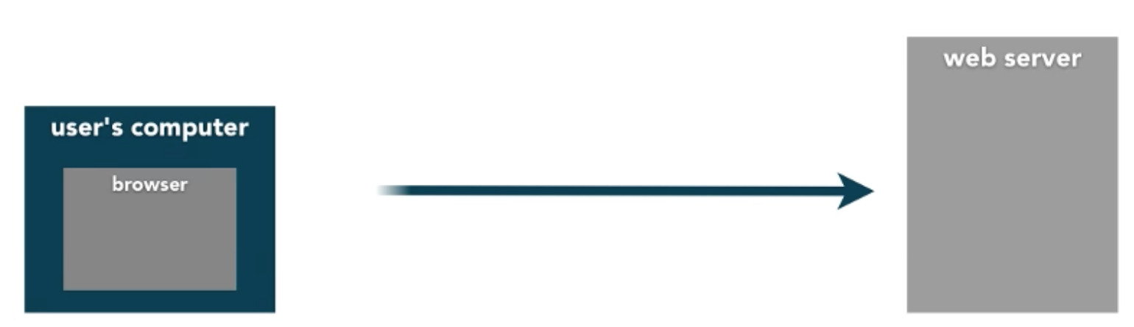
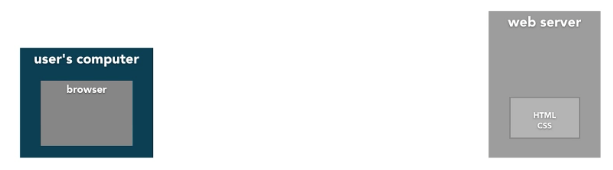
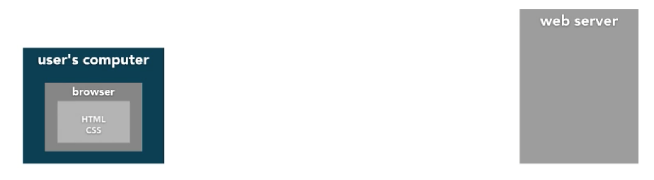
Notes:
Now as you know, when a user opens their browser and requests a page from your web site, they're just send HTML and CSS as plain text, and you let their browser take care of interpreting and rendering it however their browser wants to, whether it's mobile, whether it's on a laptop or a desktop, and it's the same with JavaScript.
JavaScript is a client-side language. It is sent to the user's computer and it runs there. That's as opposed to server-side technologies like PHP, ASP.NET, Ruby on Rails. They'll execute their code on the web server and deliver the results to the client. But with JavaScript, we just send our code to the client and we let them run it.

Slide 5
Tools
Sublime Text 2
Aptana
Xcode
Dreamweaver
VI
Emacs
Netbeans, Eclipse, Visual Studio….

Slide 6
Javascript Language
Basics
Variables, Loops, Conditionals, Functions

Slide 7
JavaScript using Node
JavaScript code inside node terminal
Run a Sample file using node terminal

Slide 8
Creating Variables
var a;
variable of name “a”,
what is “;” ?
what is var ?
why “a”?
Notes:
The name that you want to use for your variable must be written as one word, no spaces are allowed, and it can be made of letters, numbers, the underscore, and the Dollar sign, but you can't start with a number.

Slide 9
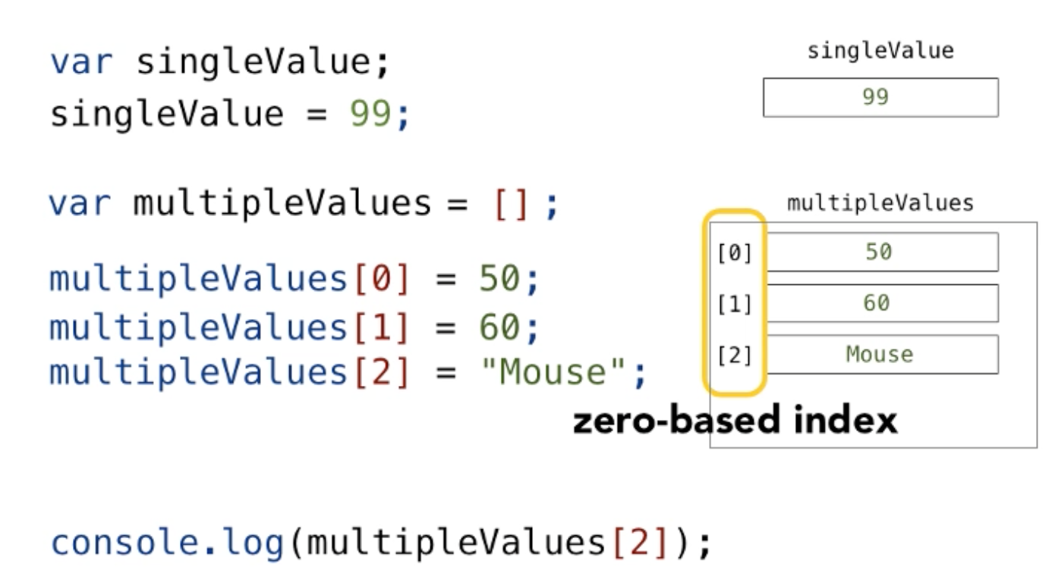
Creating Arrays
Notes:
var mu = [1,2, “abc”, 0.2];

Slide 10
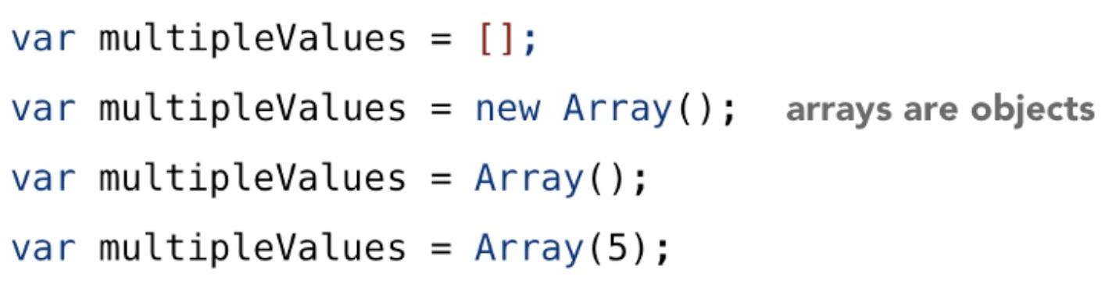
Arrays as Objects
Notes:
.concat
.join()
.sort()
.reverse();
var a = document.getElementsByName(“a”); //get all anchor tags. store it as array.

Slide 11
Challenge1-Arrays.js
Time Limit : 45 minutes
Code walkthrough: 20 minutes

Slide 12
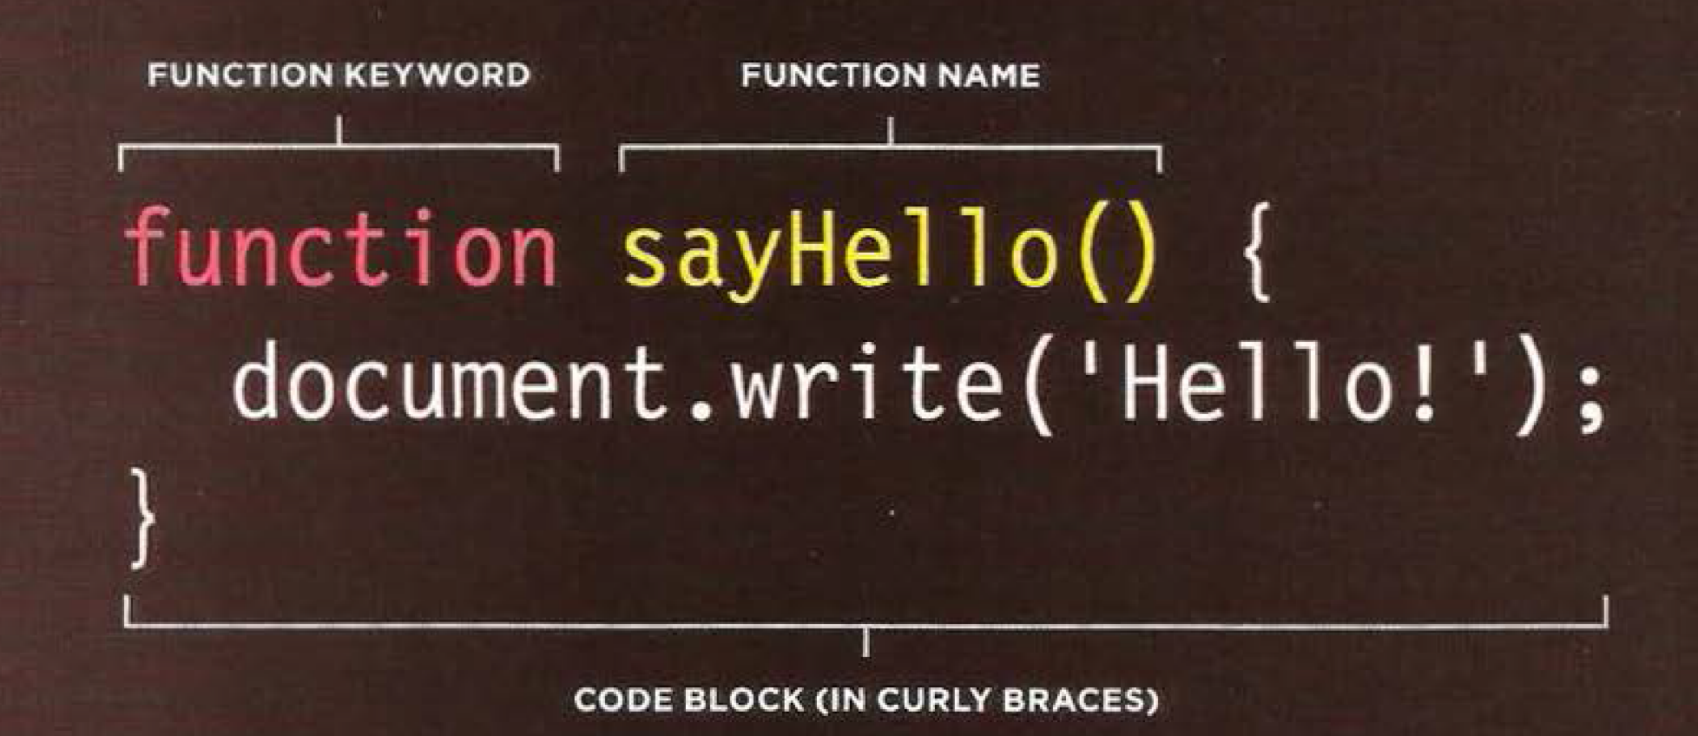
Functions

Slide 13
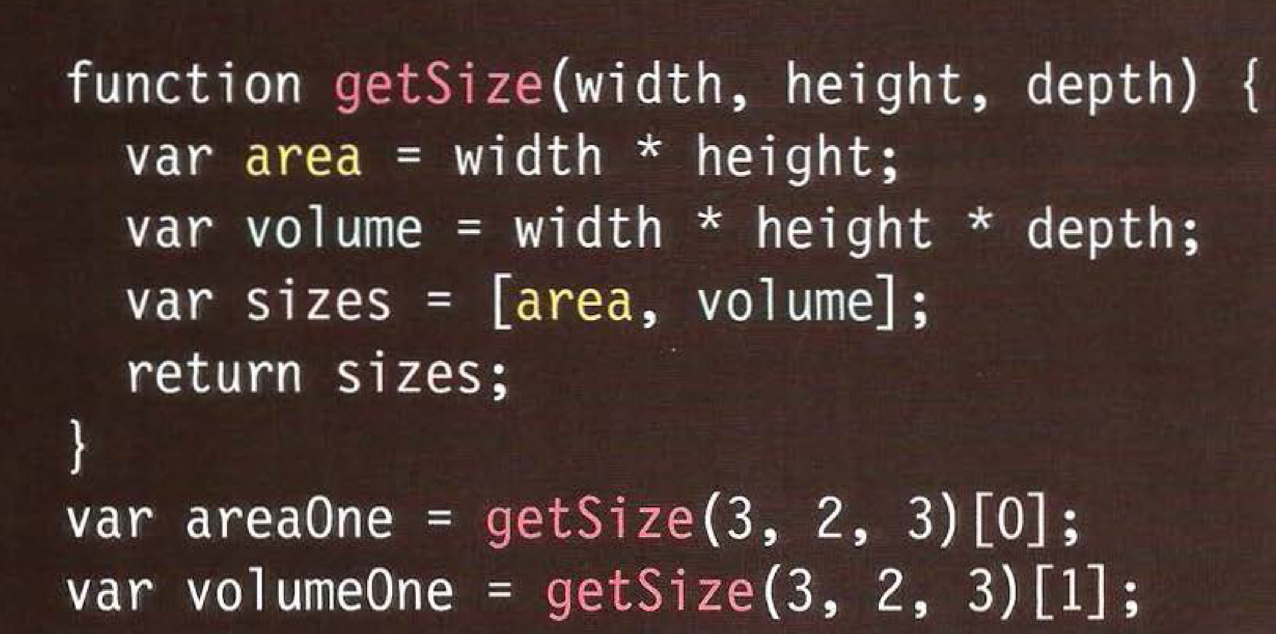
Returning Multiple values

Slide 14
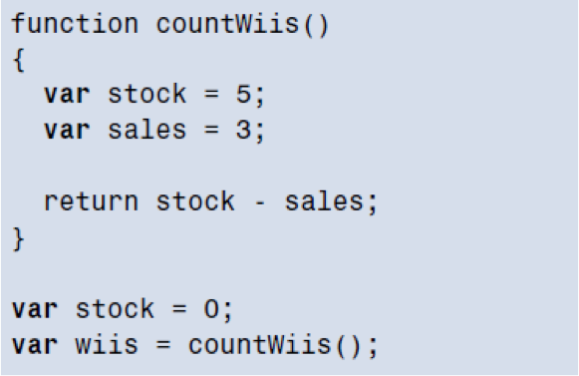
Functions
Why Functions ?
What is “return”
What is argument ?
What is function definition ?
What is function call ?
What is Scope ?
What is Global scope ?
What is Local scope ?

Slide 15
Anonymous Functions
var area = f unction(width, height) {
return width * height;
} ;
var size = area(3, 4) ;
The function is not processed until the interpreter gets to that statement.

Slide 16
Challenge2-Functions.js
Time Limit : 45 minutes
Code walkthrough: 20 minutes

Slide 17
Objects

Slide 18
Creating Objects
Objects: Group together sets of Properties and Methods
Property: variable
Method: Function
Array is a native object
Create your own objects
var robot = new Object();
var date = new Date();
Notes:
If we make an array, that's an object. If we make a date, that's an object. These objects are self-contained pieces. If I have an array, I can use the dot operator to say I'm interested in its .length. In this case it would be 5. If I have a date, I can call methods of it. Again, these are functions that belong to an object.
And at its core, the idea of an object is really simple. It's just a container that gathers together some data and some behavior. So we know how to make variables. We know how to make functions.
An object just allows us to gather variables and functions that belong together and give them a name. So let's say here I'm making some regular variables: playerName, playerScore, playerRank. It's just creating those three in memory. And I realize that really these belong together. It would be nice if I could enclose them in a larger object. Now, I could do this in an array, but I don't really want to have to worry about the 0, 1, 2 whole idea. So what I'll do instead is I'll run this line.
First off, I'll say var player--again, I'm still creating a variable--equals new Object. This creates me a generic object container and calls it player. What I then do is just decide, what do I want the internal pieces of this object to be? So in this case, player.name = "Fred", player.score = 10000, player.rank = 1. So when we do this our data is now one level deeper. It's inside this player object.

Slide 19
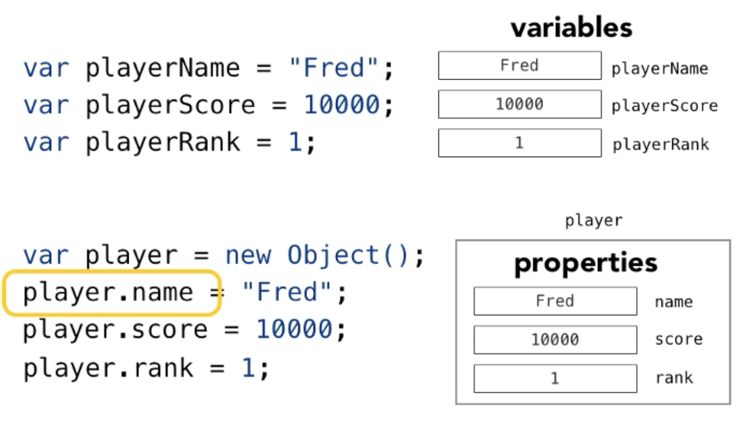
Objects

Slide 20
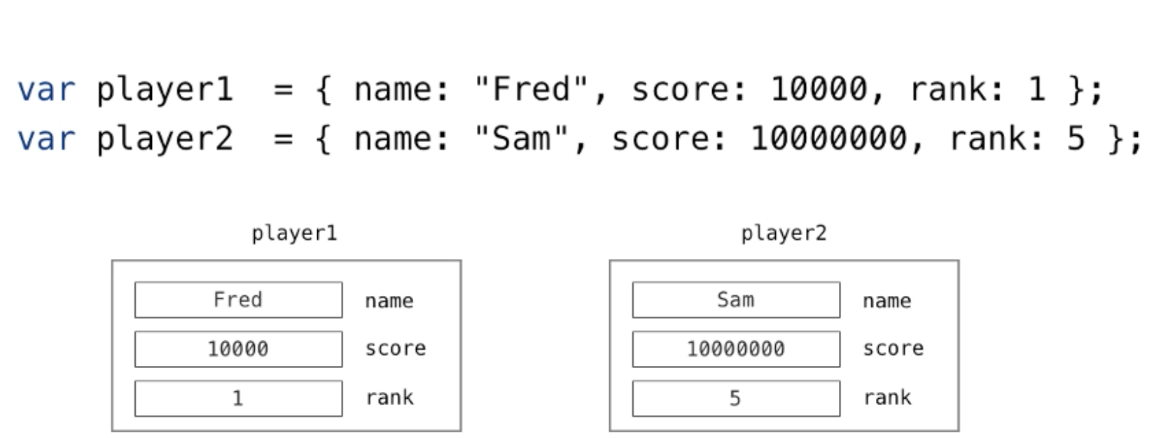
Object Creation Shorthand
Notes:
Is it JSON ? javascript object notation ?
How do you associate functions to these objects ?

Slide 21
Creating Objects Literal Notation
var objectName = {
propertyName1: “value1”,
propertyName2: “value2”
functionName: function() {
}
}

Slide 22
Creating Objects using new Object();
var objectName = new Object();
objectName.propertyName1 = “value1”;
objectName.propertyName2 = “value2”;
objectName.propertyName1 = “value1”;
objectName.functionName = function() { return “hello”;}

Slide 23
Adding functions to Objects
Var codeabode = {
className : “Server Side Integration”,
Instructor : “Kshitij”
getNumberStudent : function () {
return 10;
}
};

Slide 24
Updating an Object
ObjectName.PropertyName = ‘PropertyValue’;
ObjectName[‘propertyName’] = ‘PropertyValue’;
Example: user.name = ‘Edison’; OR
user[‘name’] = ‘Edison’

Slide 25
Deleting a Property
delete objectName.PropertyName;
Example:
delete user.name;
user.name = ‘ ’ ; (can we do this ?)
Notes:
NO, it’s just setting value to nothing.

Slide 26
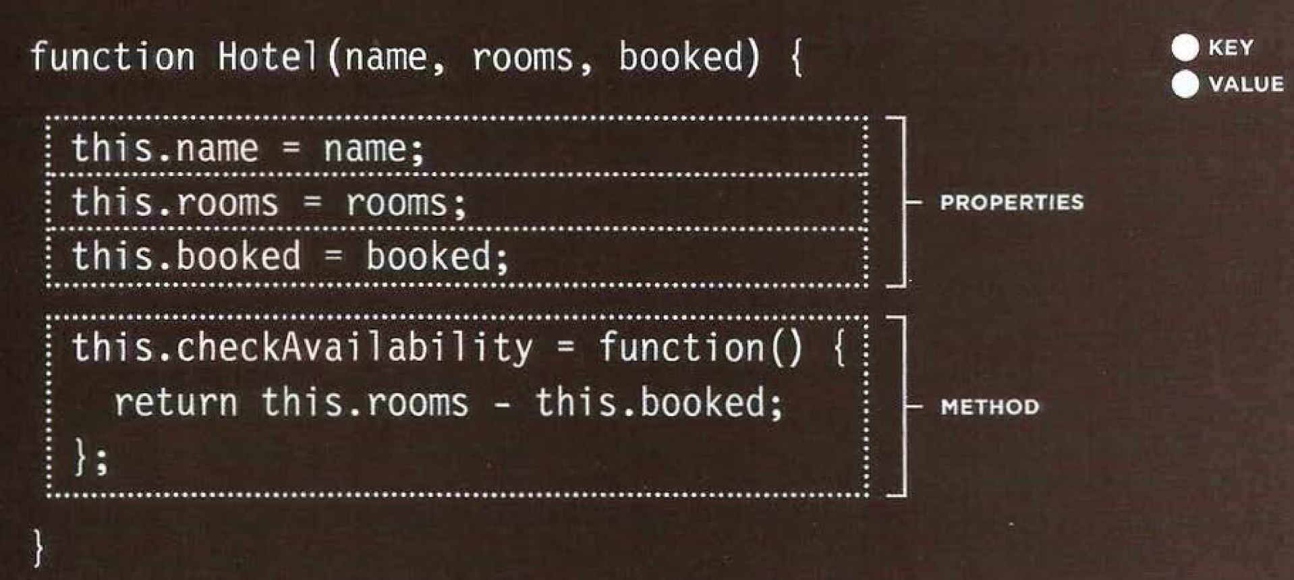
Constructor Notation
Notes:
Note:
Every line has semicolon at the end, even functions instead of comma
Key value are seperated by equals sign instead of colon.
To defined you have to use This keyword

Slide 27
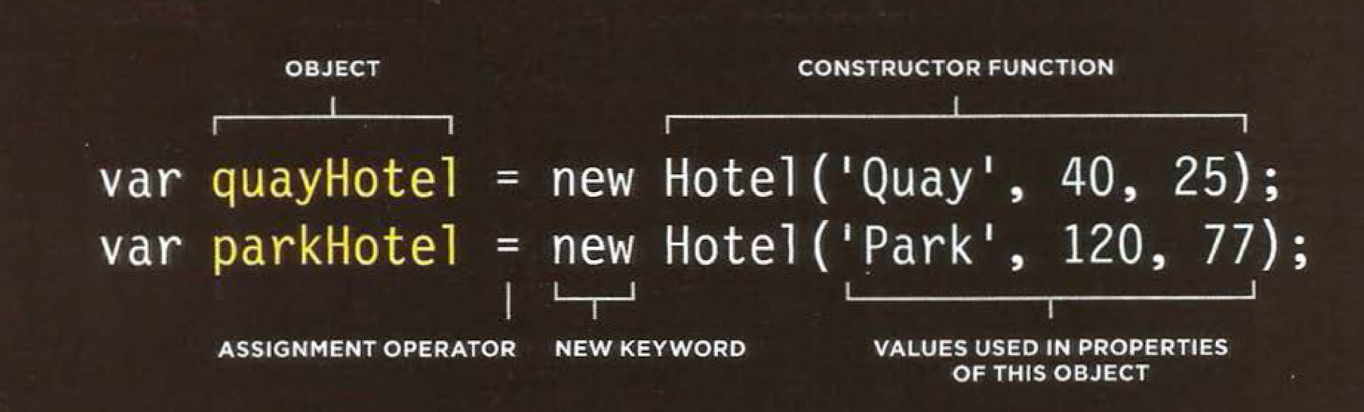
Using Constructor Notation

Slide 28
Challenge2-Objects.js
Time Limit : 45 minutes
Code walkthrough: 20 minutes

Slide 29
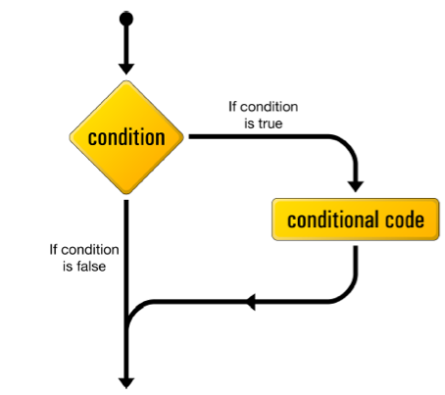
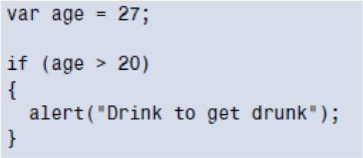
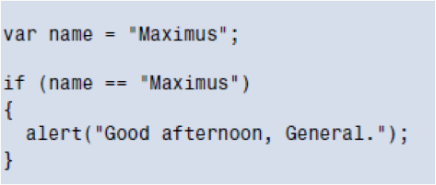
Creating Conditions
If Conditions
Notes:
The name that you want to use for your variable must be written as one word, no spaces are allowed, and it can be made of letters, numbers, the underscore, and the Dollar sign, but you can't start with a number.
Logical operators

Slide 30
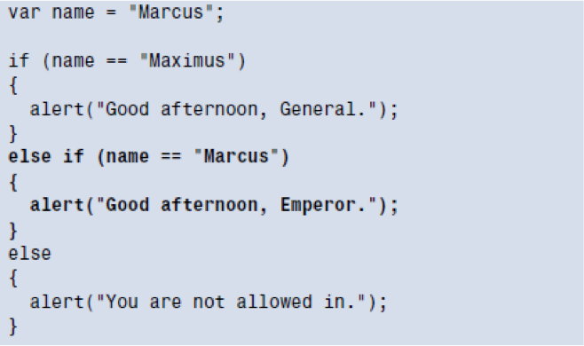
Else If

Slide 31
Other Important Concepts must Know
Logical operators
Multiple conditions ( && || !)

Slide 32
Loops
While
For
Do-While

Slide 33
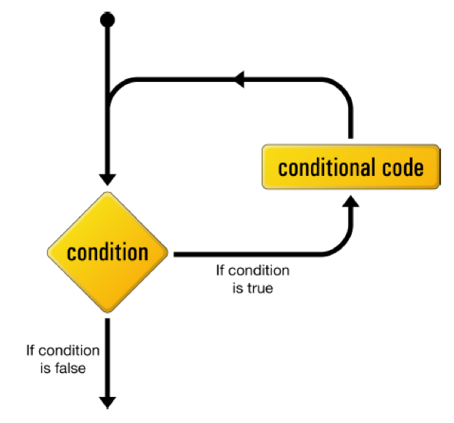
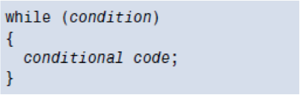
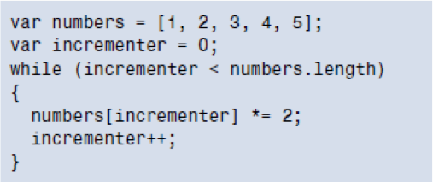
While loop

Slide 34
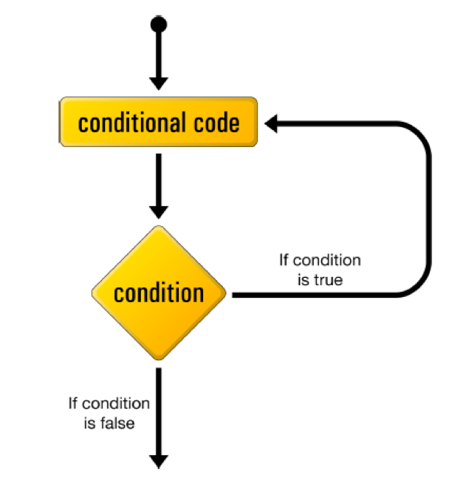
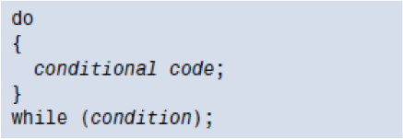
Do While

Slide 35
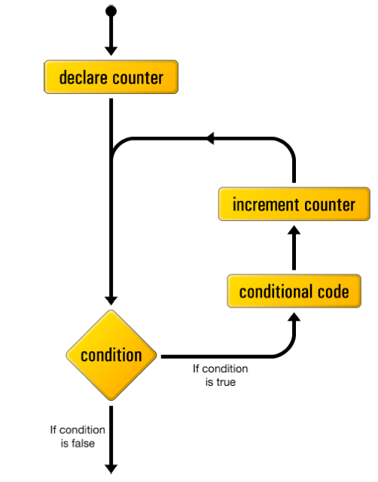
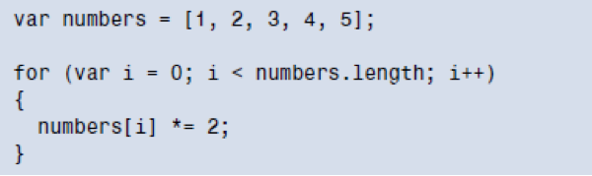
For Loop

Slide 36
Other Important Concepts must Know
Break
Continue

Slide 37
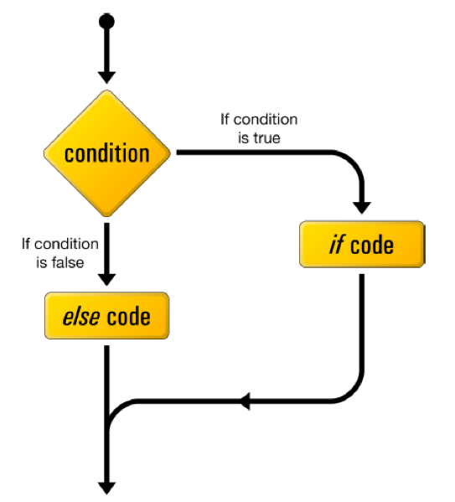
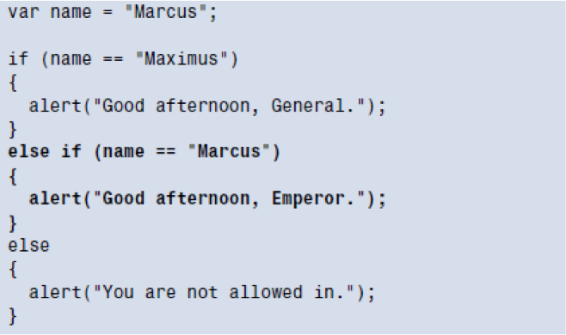
If Else

Slide 38
What Javascript can do?(True or False)
• JavaScript can change all the HTML elements in the page.
• JavaScript can change all the HTML attributes in the page.
• JavaScript can change all the CSS styles in the page.
• JavaScript can remove existing HTML elements and attributes.
• JavaScript can add new HTML elements and attributes.
• JavaScript can react to all existing HTML events in the page.
• JavaScript can create new HTML events in the page.

Slide 39
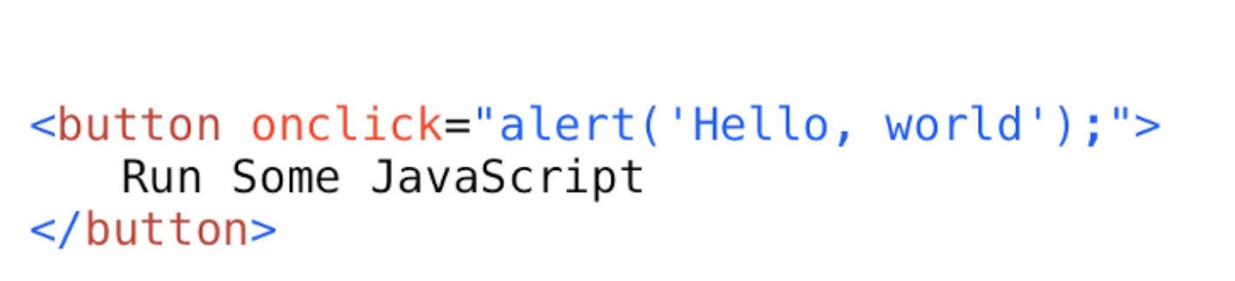
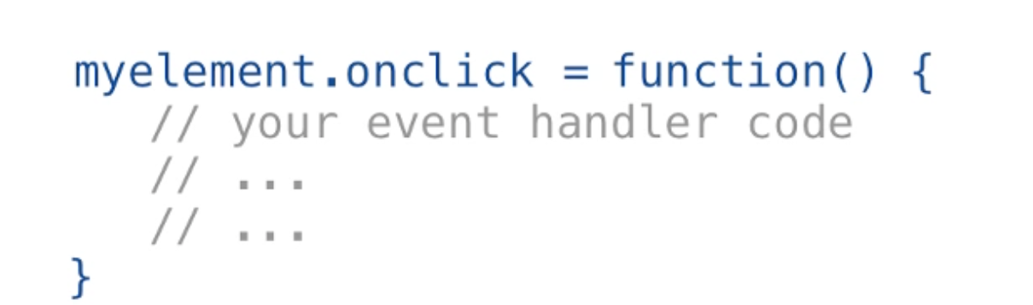
Event Handling
What is an Event ?
IE doesn’t have addEventListner, it has attachEvent
Notes:
. When the page is loaded, that's an event; when the user clicks a button, that's another event; when they move their mouse, that's a whole bunch of events; when they scroll the screen, that's an event; when they click a form field, that's an event; as they type, every key press is another event. Events are going on all the time. You have to decide which ones you care about. See, these events are built into JavaScript. They're part of JavaScript, and there are special words to describe them. You'll see them typically written all lowercase, and they begin with the word on, so onload, onclick, onmouseover, onblur, onfocus, and we'll see several of these in . But you don't write the event itself. You write what's called the event handler or the event listener, whatever term you prefer.

Slide 40
Client Side JavaScript Review Session using Node command(ends)
Learn more from W3Schools or YouTube or any book that you like ☺

